Slide 1
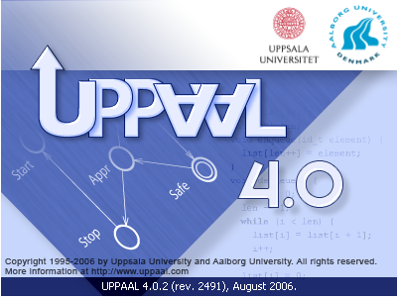
Real Time Model Checking, Performance Evaluation, Synthesis and Optimization
Kim G. Larsen
Aalborg University, DENMARK
TexPoint fonts used in EMF.
Read the TexPoint manual before you delete this box.: AAAAAAAA
Notes:
DG
Verification and Validation of Real-Time and Embedded Systems
Professor Kim G Larsen
CISS, Aalborg University Denmark
Model-driven development has been proposed as a way to deal with the increasing complexity of real-time and embedded systems, while reducing the time and cost to market. The use of models should permit early assessment of the functional correctness of a given design as well as requirements for resources (e.g. energy, memory, and bandwidth) and real-time and performance guarantees.
In the lecture we will introduce the tool UPPAAL providing an integrated environment for modeling, validation, verification and synthesis of real-time systems modeled as networks timed automata, extended with data types and user-defined functions. The lectures will provide details on the expressive power of timed automata in relationship to embedded systems as well as details on the power and working of the UPPAAL verification engine.
Particular attention will be given to the theory of the underlying formalisms of UPPAAL, including timed automata, priced timed automata, and (priced) timed games addressing a number of associated decision problems related to model-checking and optimal scheduling and strategies. Also, the frontier of decidability will be drawn including pointing out a number of open problems.
The lectures will also emphasize the research effort in design algorithms and datastructures for efficient analysis on practical and industrial cases.
FSEN’09
This talk will introduce various recent extensions of the by know well-established formalism of timed automata. The talk apply these extension to verification, optimal scheduling, performance analysis and controller synthesis of real-time and embedded systems.
The timed automata extensions considered -- priced timed automata, game timed automata as well as probabilistic timed automata -- are all supported by various branches of the real-time verificaiton tool UPPAAL (www.uppaal.com) which will be demonstrated during the talk. Also, the development of algorithms and datastructures applied by UPPAAL for the efficient analysis of these models is provided.
Validation, Performance Analysis and Synthesis of Embedded Systems
Kim G Larsen
Within the upcoming European Joint Technology Initiative ARTEMIS as well as several national initiatives such as CISS (www.ciss.dk) and DaNES (http://www.danes.aau.dk/), model-driven development is a key to dealing with the increasing complexity of embedded systems, while reducing the time and cost to market. The use of models should permit early assessment of the functional correctness of a given design as well as requirements for resources (e.g. energy, memory, and bandwidth) and real-time and performance guarantees. Thus, there is a need for quantitative models allowing for timed, stochastic and hybrid phenomenas to be modeled an analysed.
UPPAAL and the branches CORA and TIGA provide an integrated tool environment for modelling, validation, verification and synthesis of real-time systems modelled as networks timed automata, extended with data types and user-defined functions. The talk will provide details on the expressive power of timed automata in relationship to embedded systems as well as details on the power and working of the UPPAAL verification engine.
In this talk we demonstrate how UPPAAL has been applied to the validation, performance analysis and synthesis of embedded control problems. The applications include so-called task graph scheduling and MPSoC systems consisting of application software running under different RTOS on processors interconnected through an on-chip network. Also we show how CORA and TIGA has been used to synthesize optimal (e.g. wrt. energy or memory) scheduling strategies given applications, including Dynamic Voltage Scaling and a climate controller.

Slide 2

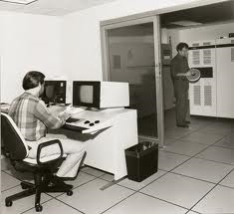
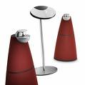

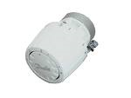
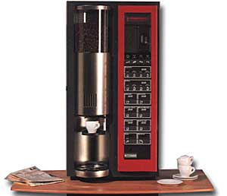
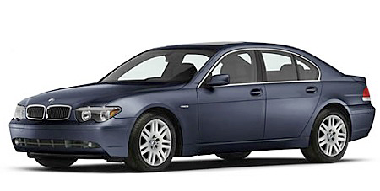
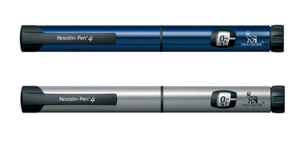
From Computer Science to
Embedded Systems
Notes:
IDEA4CPS is rooted in Theoretical Computer Science .. You now the science where skilled programmers and operators can make very big computers do complex calculations of typically high scientific importance .. This I guess I Arne in the old Data Center. We actually still have such big instalments doing HPC – PC clusters or GRIDS.
The underlying foundation here is that of “computable functions” – i.e. a computing system can be understood as a function from input to output and the art is now to prove that you function implemented by a particular program does the right thing. Denotational and Axiomatic Semantics, Abstract Interpretation .. Etc are usefull. BRICS .. Perhabs ..
The first step toward taking computers and programs out of the clean room is that of embedded systems. Here dedicated computers and programs monitor and control a particular proces .. The underlying foundation here is that “reactive system”, the system is understood in term sof its interaction with the environment. Concurrency theory.

Slide 3
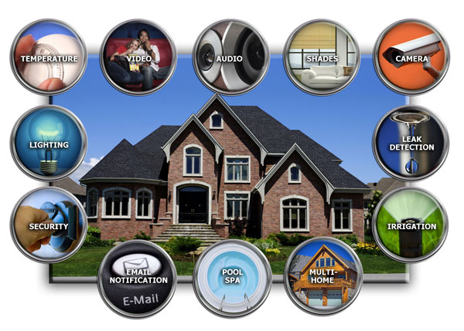
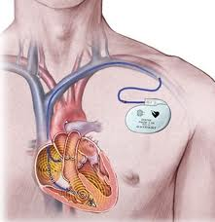
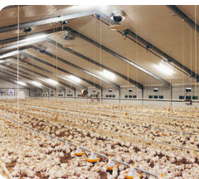

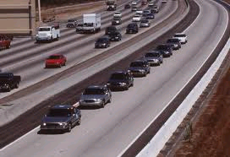
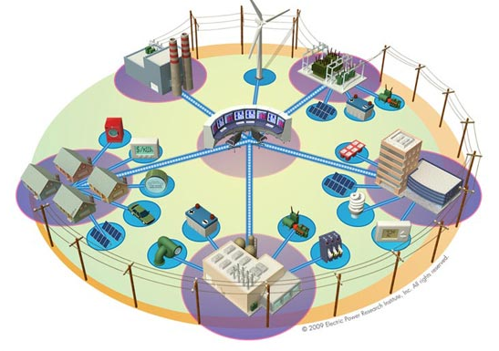
From Computer Science to
Cyber Physical Systems
Discrete
New Foundation
Discrete Models
(Boolean correctness)
→
Quantitive Models
(time, resources,
probabilistic, stochastic,
continuous,..)
(Quantitative correctness)
Real Time
Resources
Stochasticity
Hybrid
Notes:
Cyber-Physical Systems is like embedded systems on speed – or several embedded systems interacting in a loose typically adhoc network.
Examples found in future devices in homes … telemedicin. Not just software in the individual car but also interaction between cars for fast mauvering or safe manuvering (collisiton avoidance) – or large intelligent sensor networks in stables.
Properties – need for foundation!
A trend – US invented Cyber Physical Sysstems; China has launced a big initiative and also Germany is planning an initiative
Happy that we can contribute

Slide 4
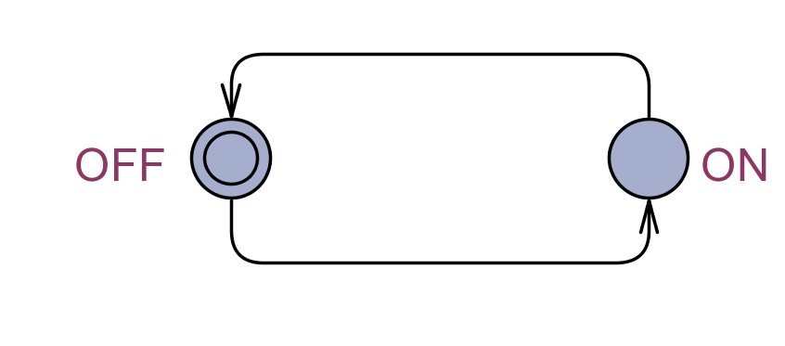
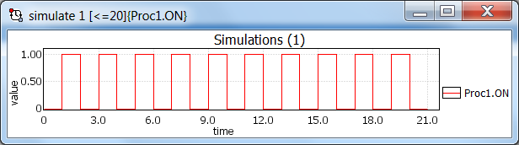
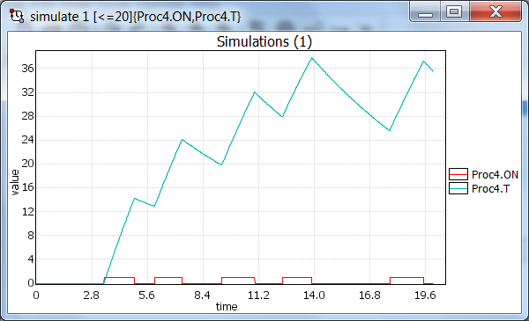
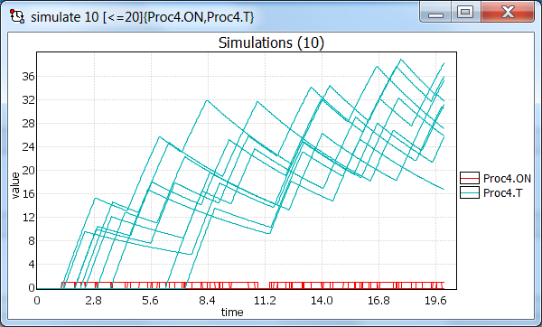
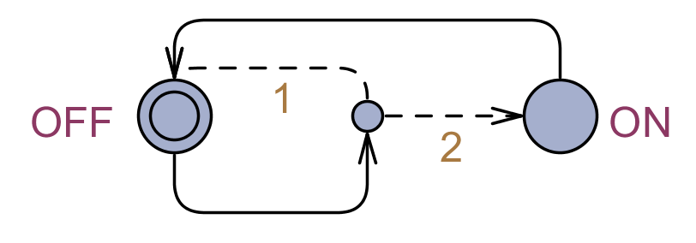
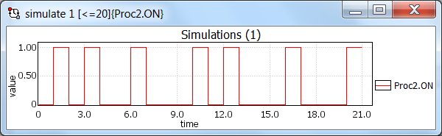
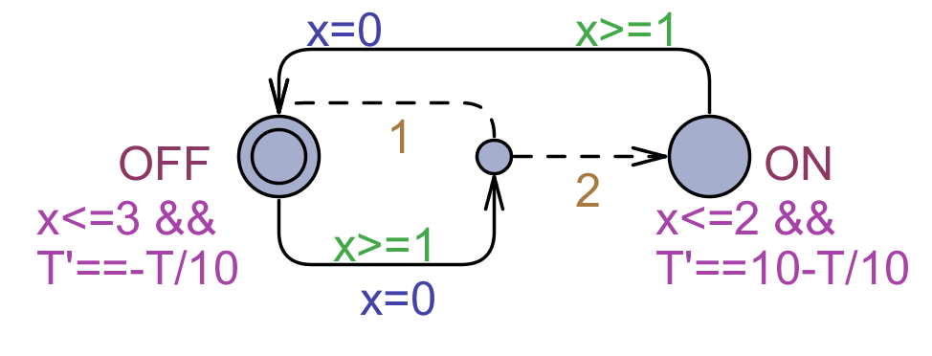
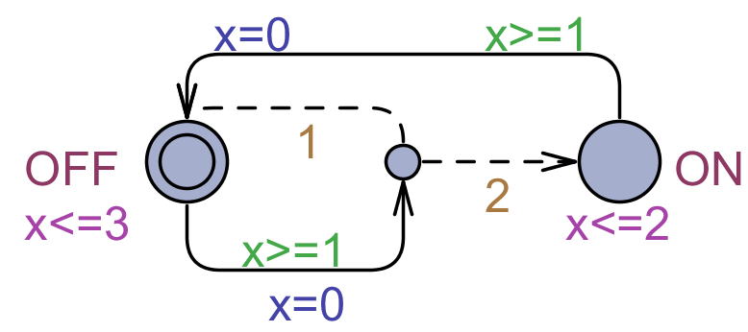
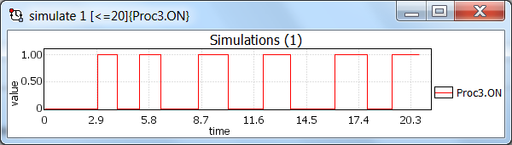
Models
Discrete
ALW( OFF) EVEN ON)
Probabilistic
ALW( OFF) EVEN_{s<3, p>0.90} ON)
Timed
ALW( OFF) EVEN_{t<5, p>0.90} ON)
Hybrid
ALW( T<3) EVEN_{t<20, p>0.90} T>20)

Slide 5
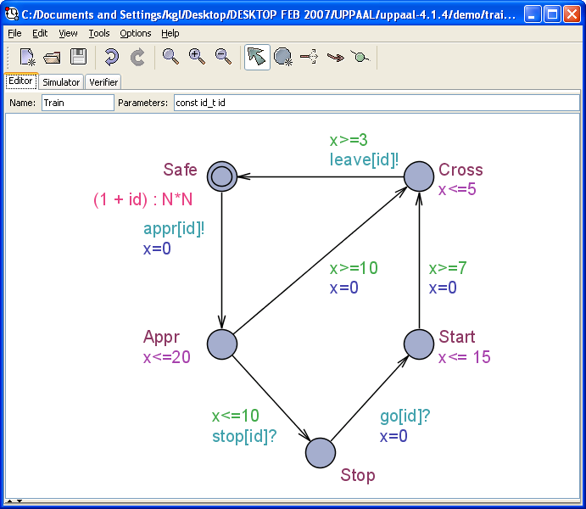
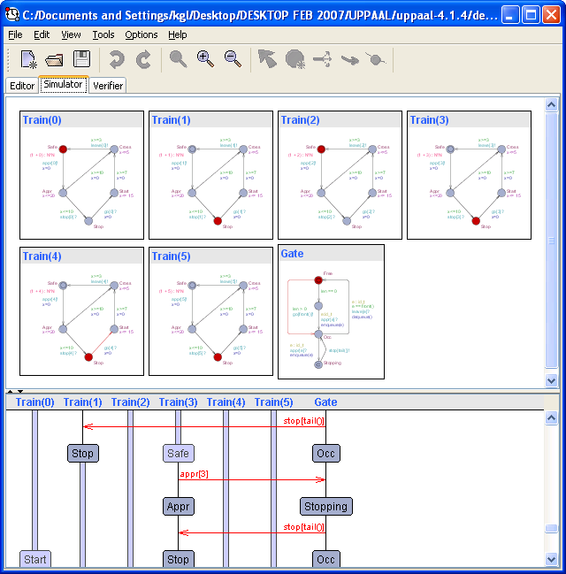
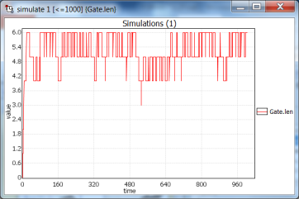
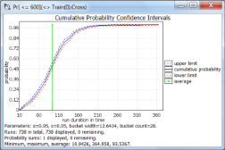
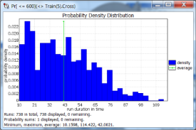
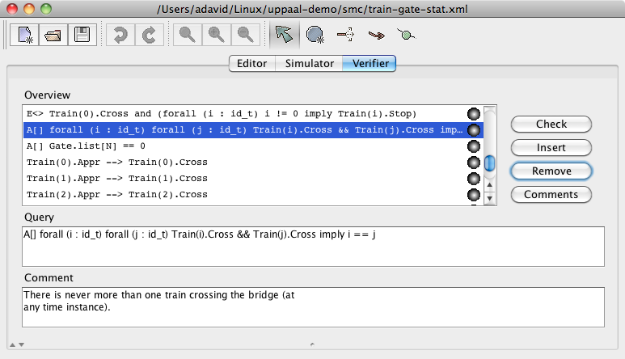
UPPAAL Tool Suit
CLASSIC
Verification
Optimization
CORA
Synthesis
TIGA
Component
ECDAR
Testing
TRON
Performance
Analysis
SMC
Optimal Synthesis
STRATEGO

Slide 6
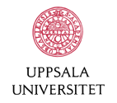

Contributors
@UPPsala
  Wang Yi
  Paul Pettersson
  John Håkansson
  Anders Hessel
  Pavel Krcal
  Leonid Mokrushin
  Shi Xiaochun
@AALborg
  Kim G Larsen
  Alexandre David
  Marius Mikucionis
  Gerd Behrman
  Arne Skou
  Brian Nielsen
  Jacob I. Rasmussen
  Thomas Chatain
@Elsewhere
  Emmanuel Fleury, Didier Lime, Johan Bengtsson, Fredrik Larsson, Kåre J Kristoffersen, Tobias Amnell, Thomas Hune, Oliver Möller, Elena Fersman, Carsten Weise, David Griffioen, Ansgar Fehnker, Frits Vandraager, Theo Ruys, Pedro D’Argenio, J-P Katoen, Jan Tretmans, Judi Romijn, Ed Brinksma, Martijn Hendriks, Klaus Havelund, Franck Cassez, Magnus Lindahl, Francois Laroussinie, Patricia Bouyer, Augusto Burgueno, H. Bowmann, D. Latella, M. Massink, G. Faconti, Kristina Lundqvist, Lars Asplund, Justin Pearson...
Notes:
Here you see all the contributers over the years.

Slide 7
Overview
Timed Automata / UPPAAL
  Verification
Stochastic Priced Timed Automata / UPPAAL SMC
  Performance Evaluation
  SMC in a Nutshell
  Stochastic Hybrid Automata
Timed Games / UPPAAL TIGA
  Controller Syntesis
Stochastic Priced Timed Games / UPPAAL STRATEGO
  Optimal & Safe Synteses
Conclusion
  Schedulability Analysis
  Production Cell, .., HYDAC Case
  Adaptive Cruice Control

Slide 8
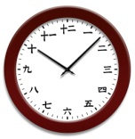
Timed Automata

Slide 9
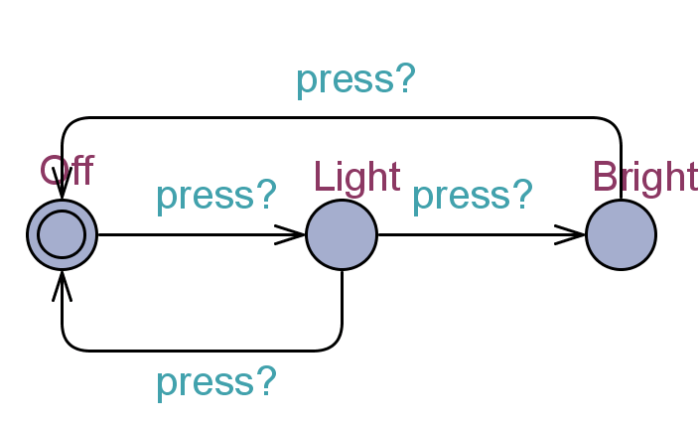
A Dumb Light Controller

Slide 10

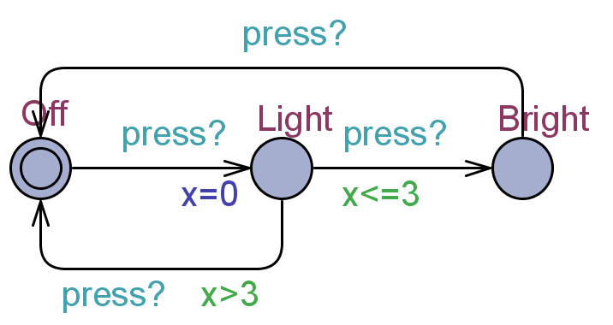

Timed Automata
[Alur & Dill’89]
Synchronizing action
Reset
Clock Guard
Conjunctions of x~n
x: real-valued clock
ADD a clock x

Slide 11
A Timed Automata (Semantics)
States:
( location , x=v) where v2R
Transitions:
( Off , x=0 )
delay 4.32 → ( Off , x=4.32 )
press? → ( Light , x=0 )
delay 2.51 → ( Light , x=2.51 )
press? → ( Bright , x=2.51 )

Slide 12
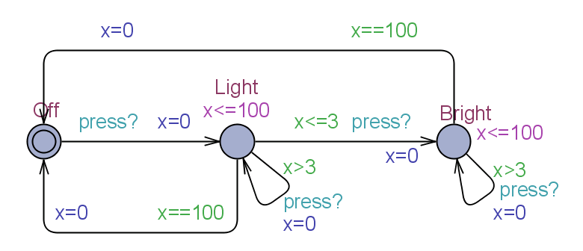
Intelligent Light Controller
Invariant (Henzinger)

Slide 13
Intelligent Light Controller
X
Transitions:
( Off , x=0 )
delay 4.32 → ( Off , x=4.32 )
press? → ( Light , x=0 )
delay 4.51 → ( Light , x=4.51 )
press? → ( Light , x=0 )
delay 100 → ( Light , x=100)
τ → ( Off , x=0)
Note:
( Light , x=0 ) delay 103 →
Invariants ensures progress

Slide 14
Train Crossing
Safe
Approaching
Crossing
Safe
River
Bridge
tracks
Time
0
20
3 – 5

Slide 15
Train Crossing
Safe
Approaching
Crossing
Safe
Safe
Approaching
Crossing
Safe
River
Bridge
tracks
Time
0
10
20
3 – 5
Stop the train while it still stoppable!

Slide 16
Train Crossing
Crossing
Safe
Approaching
Crossing
Safe
Safe
Safe
Approaching
Crossing
Safe
Crossing
Safe
Crossing
Stopped
Stopped
Restarted
Restarted
River
Bridge
tracks
7 – 15
Time
0
10
20
3 – 5

Slide 17
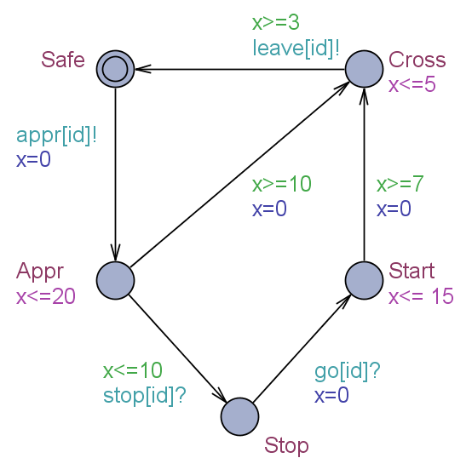
Train Crossing
Safe
Approaching
Crossing
Safe
Add timing+ synchronization
Stopped
Restarted

Slide 18
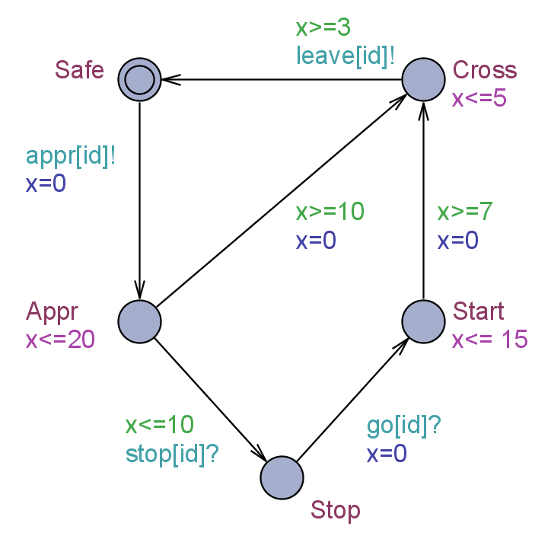
Timed Automata [Train]
= Finite State Control
+ Real Valued Clocks
invariants
Resets
Guards
Synchronizations
SEMANTICS
( Appr , x=0 ) -5.2->
( Appr , x=5.2 ) –stop? ->
( Stop , x=5.2 )

Slide 19
DEMO

Slide 20
Logical Specifications
Validation Properties
  Possibly: E<> P
Safety Properties
  Invariant: A[] P
  Pos. Inv.: E[] P
Liveness Properties
  Eventually: A<> P
  Leadsto: P → Q
Bounded Liveness
  Leads to within: P →_{· t} Q
The expressions P and Q must be type safe, side effect free, and evaluate to a boolean.
Only references to integer variables, constants, clocks,
and locations are allowed (and arrays of these).

Slide 21
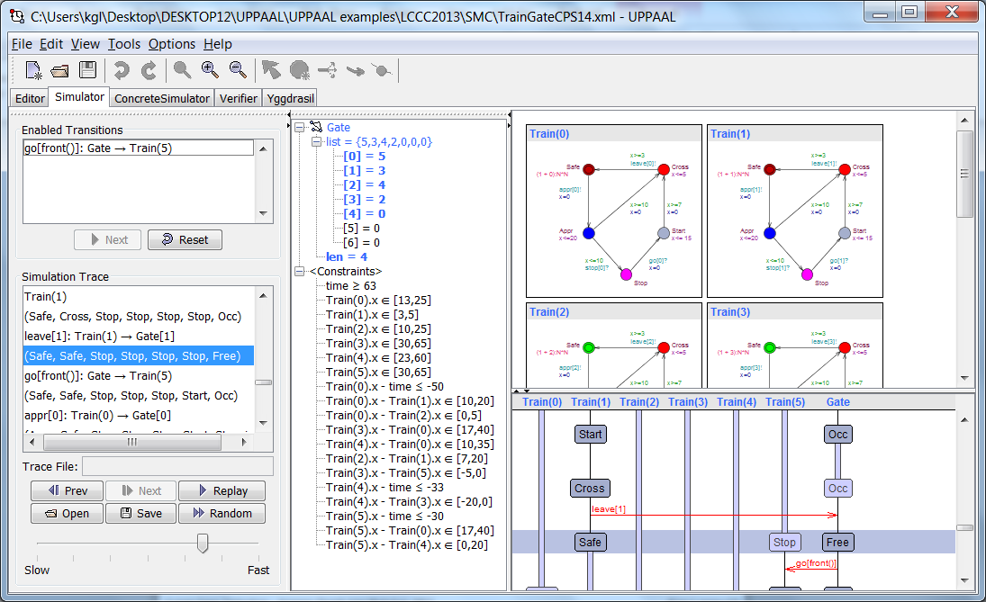
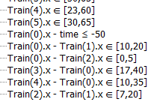
THE ”secret” of UPPAAL

Slide 22
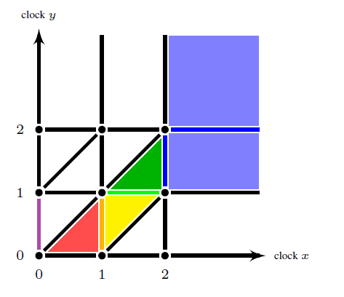
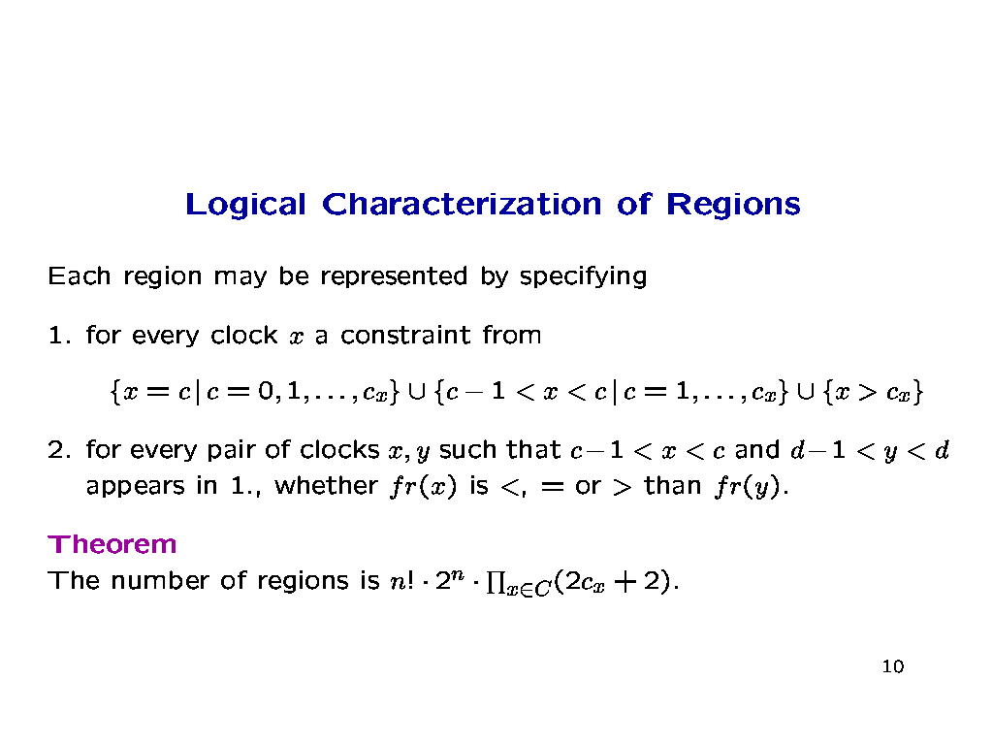
Zones – From Finite to Efficiency
A zone Z:
1· x · 2 Æ
0· y · 2 Æ
x - y ¸ 0

Slide 23
Zones - Operations
(n, 2·x·4 Æ
1·y·3 Æ y-x·0 )
(n, 2·x Æ
1·y Æ -3· y-x·0 )
(n, 2·x Æ
1·y·3 Æ y-x·0 )
y
y
y
x
x
x
Delay
Delay (stopwatch)
y
(n, x=0 Æ 1·y·3 )
y
(n, 2·x·4Æ 1·y )
y
2
x
x
x
Reset
Extrapolation
Convex Hull

Slide 24
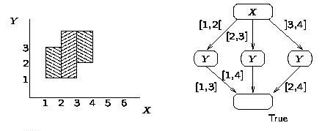
Datastructures for Zones
Difference Bounded Matrices (DBMs)
Minimal Constraint Form
[RTSS97]
Clock Difference Diagrams
[CAV99]
-4
x1
x2
4
3
3
-2
-2
2
2
x0
1
x3
5

Slide 25
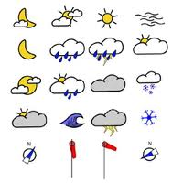

Stochastic Timed Automata

Slide 26
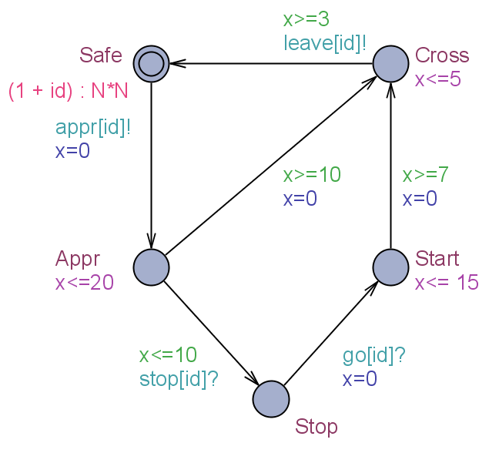
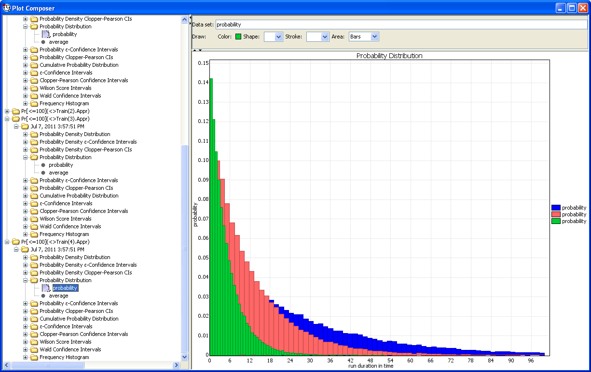
Stochastic Semantics of TA
Exponential Distribution
Uniform Distribution
1
0.5
1
2
3
4
5
Composition =
Repeated races between components for outputting
Input enabled

Slide 27
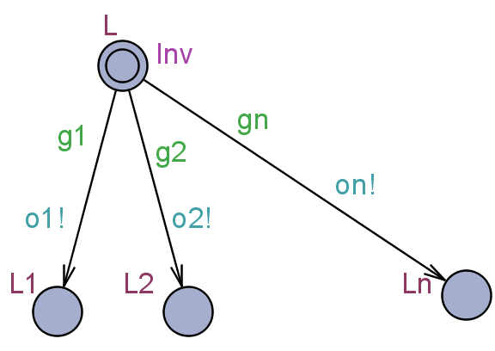
Stochastic Semantics of
Timed Automata
g1
g2
s
Delay Density Function
¹_{s}: R! R
Output Probability Function
°_{s}: §_{o}! [0,1]
¹_{s} uniform on [ d_{min}, d_{max} ]
°_{s} uniform over enabled outputs

Slide 28
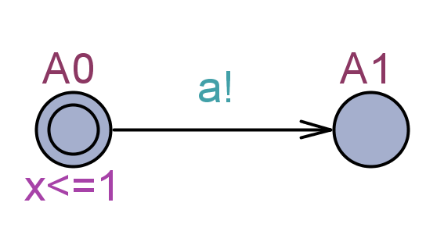
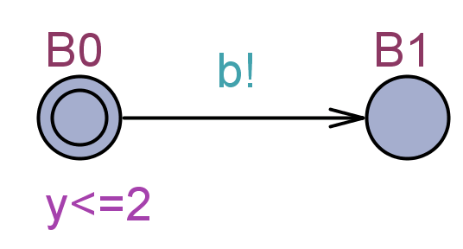
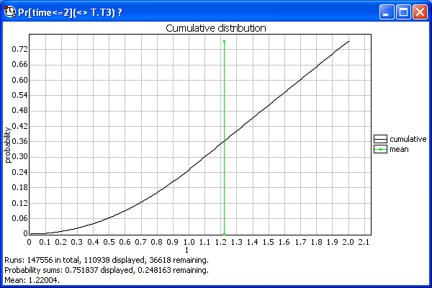
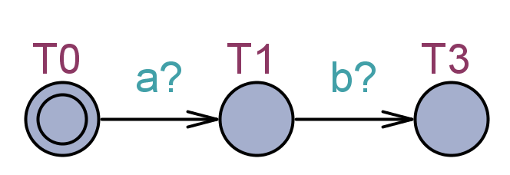
Composition of STA
Pr[time<=2](<> T.T3) ?
Pr[time<=T](<> T.T3) ?
Composition = Race between components
for outputting

Slide 29




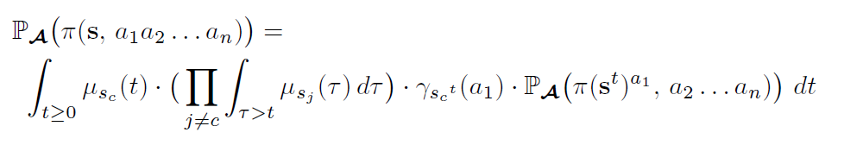
Stochastic Semantics of TA
Assumptions:
Component TAs are:
  Input enabled
  Deterministic
  Disjoint set of output actions
Delay Density Function
¹_{s}: R! R
Output Probability Function
°_{s}: §_{o}! [0,1]
¼ ( s , a₁ a₂ …. a_{n} ) :
the set of maximal runs from s with a prefix
t₁ a₁ t₂ a₂ … t_{n} a_{k}
for some t₁,…,t_{n} 2 R.

Slide 30
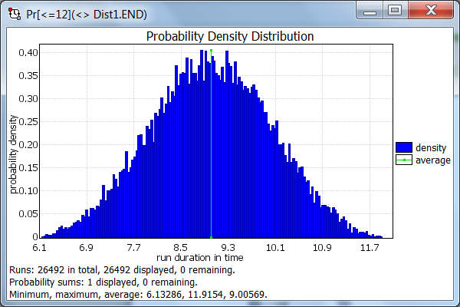
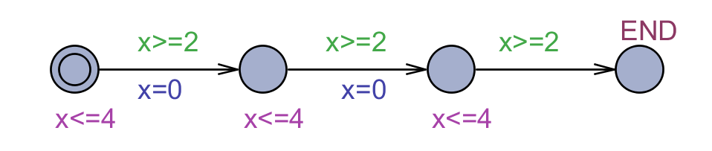




Beyond Uniform / Exponential Dist.
Includes all Phase-Type
Distributions.
Can encode any distribution with
arbitrary precision.

Slide 31


Statistical Model Checking
[FORMATS11,
LPAR12, RV12]
M
Generate
random run $π$
}_{<T} p
Á
Validate
$π⊨φ ?$
Inconclusive
µ, ²
p,®
Core Statistical
Algorithm
Hypothesis
testing
Confidence
Interval
Pr_{M}(Á) ¸ p
at significance level ®
Pr_{M}(Á) 2 [a-²,a+²]
with confidence µ

Slide 32
Queries in UPPAAL Syntax
Evaluation
Pr[<=100](<> expr)
Hypothesis testing
Pr[<=100](<> expr)>=0.1
c<=100 #<=50 [] expr <=0.5
Comparison
Pr[<=20](<> e1)>=Pr[<=10](<> e2)
Expected value
E[<=10;1000](min: expr)
Explicit number of runs. Min or max.
Simulations
simulate 10 [<=100]{expr1,expr2}

Slide 33
DEMO

Slide 34



Stochastic Hybrid Systems
A Bouncing Ball
Player 1
Player 2

Slide 35






Stochastic Hybrid Systems
A Bouncing Ball
Player 1
Ball
Player 2
simulate 1 [<=20]{Ball1.p, Ball2.p}
Pr[<=20](<>(time>=12 && Ball1.p>4))
Pr[<=20](<> (time>=12 && Ball1.p>4)) >=
Pr[<=20](<> (time>=12 && Ball2.p>4))

Slide 36







Stochastic Hybrid Systems
Room 1
simulate 1 [<=100]{Temp(0).T, Temp(1).T}
simulate 10 [<=100]{Temp(0).T, Temp(1).T}
Pr[<=100](<> Temp(1).T<=5 and time>30) >= 0.2
on/off
Heater
Pr[<=100](<> Temp(0).T >= 10)
Room 2
on/off

Slide 37
Stochastic Hybrid Systems
A Bouncing Ball
UPPAAL SMC
Uniform distributions (bounded delay)
Exponential distributions (unbounded delay)
Syntax for discrete probabilistic choice
Distribution on next state by use of random
GUI for plot composing and exporting
Hybrid flow by use of ODEs
+ usual stuff (structured variables, user-defined types
user-defined functions, ….)
MITL
Networks
Repeated races between components for outputting
Player 1
Ball
Player 2
simulate 1 [<=20]{Ball1.p, Ball2.p}
Pr[<=20](<>(time>=12 && Ball.p>4))

Slide 38

Schedulability
& Performance Analysis
??

Slide 39
Task Scheduling
utilization of CPU
P(i), UNI[E(i), L(i)], .. : period or
earliest/latest arrival or .. for T_{i}
C(i), UNI[BC(i),WC(i)] : execution time for T_{i}
D(i): deadline for T_{i}
T₁
ready
done
Scheduler
T₂
2
4
1
3
stop
run
T_{n}
{ T₄ , T₁ , T₃ } ready
ordered according to some
given priority:
(e.g. Fixed Priority, Earliest Deadline,..)
T₂ is running

Slide 40

Modeling Task
T₁
ready
done
Scheduler
T₂
2
4
1
3
stop
run
T_{n}

Slide 41

Modeling Scheduler
T₁
ready
done
Scheduler
T₂
2
4
1
3
stop
run
T_{n}

Slide 42

Modeling Queue
T₁
ready
done
Scheduler
T₂
2
4
1
3
stop
run
T_{n}
……

Slide 43


Schedulability Analysis
simulate 1 [<=400]
{ Task0.Ready + 2*Task0.Running +3*Task0.Blocked,
Task1.Ready + 2*Task1.Running +3*Task1.Blocked + 4,
Task2.Ready + 2*Task2.Running + 3*Task2.Blocked + 8,
Task3.Ready + 2*Task3.Running + 3*Task3.Blocked +12 }
A[] not (Task0.Error or Task1.Error
or Task2.Error or Task3.Error)
☺
const int E[N] = { 200, 200, 100, 100 };
const int L[N] = { 400, 200, 100, 100 }; // Ready interval
const int D[N] = { 400, 200, 100, 100 }; // Deadlines
const int WC[N] = { 60, 40, 20, 10 }; // Worst Computation Times
const int BC[N] = { 20, 20, 10, 5 }; // Best Computation Times
const int P[N] = { 1, 2, 3, 4 }; // Priorities

Slide 44



Schedulability Analysis
😐
😐
☺
☺
A[] (not Taski.Error) i : 0,1,2,3
Pr[<=4000]
( <> Task0.Error or Task1.Error
or Task2.Error or Task3.Error)
simulate 10000 [<=400]
{ Task0.Ready + 2*Task0.Running +3*Task0.Blocked,
Task1.Ready + 2*Task1.Running +3*Task1.Blocked + 4,
Task2.Ready + 2*Task2.Running + 3*Task2.Blocked + 8,
Task3.Ready + 2*Task3.Running + 3*Task3.Blocked +12 }
: 1 : (Task0.Error or Task1.Error or Task2.Error or Task3.Error)
const int E[N] = { 200, 200, 100, 100 };
const int L[N] = { 400, 200, 100, 100 }; // Ready interval
const int D[N] = { 400, 200, 100, 100 }; // Deadlines
const int WC[N] = { 60, 40, 20, 60 }; // Worst Computation Times
const int BC[N] = { 20, 20, 10, 5 }; // Best Computation Times
const int P[N] = { 1, 2, 3, 4 }; // Priorities

Slide 45

Performance Analysis
sup : Task2.r, Task3.r

Slide 46




Performance Analysis
E[<=800; 5000] (max: Task0.r)
E[<=800; 5000] (max: Task0.r)
E[<=800; 5000] (max: Task0.r)
E[<=800; 5000] (max: Task0.r)
D=100
D=400
D=200
D=100

Slide 47

Herschel-Planck Scientific Mission at ESA
Attitude and Orbit Control Software
TERMA A/S Steen Ulrik Palm, Jan Storbank Pedersen, Poul Hougaard

Slide 48


Herschel & Planck Satelites
Application software (ASW)
  built and tested by Terma:
  does attitude and orbit control, tele-commanding, fault detection isolation and recovery.
Basic software (BSW)
  low level communication and scheduling periodic events.
Real-time operating system (RTEMS)
  Priority Ceiling for ASW,
  Priority Inheritance for BSW
Hardware
  single processor, a few communication buses, sensors and actuators.
Requirements:
  Software tasks should be schedulable.
  CPU utilization should not exceed 50% load

Slide 49

Modeling in UPPAAL
UPPAAL 4.1 Framework
ISoLA 2010

Slide 50

Gantt Chart 1. cycle

Slide 51


Blocking & WCRT
Marius Micusionis

Slide 52

Effort and Utilization
Marius Micusionis

Slide 53

TERMA Case Conclusion

Slide 54

TERMA Case Follow-Up
ISOLA 2012
f=100%
f=95%
[ f*WCET, WCET]
1 Day
6 Days
f=90%
f=86%

Slide 55

TERMA Case - Statistical MC

Slide 56



TERMA Case – Conclusion

Slide 57
Timed Games
TIGA
Notes:
FSEN’09
This talk will introduce various recent extensions of the by know well-established formalism of timed automata. The talk apply these extension to verification, optimal scheduling, performance analysis and controller synthesis of real-time and embedded systems.
The timed automata extensions considered -- priced timed automata, game timed automata as well as probabilistic timed automata -- are all supported by various branches of the real-time verificaiton tool UPPAAL (www.uppaal.com) which will be demonstrated during the talk. Also, the development of algorithms and datastructures applied by UPPAAL for the efficient analysis of these models is provided.
Validation, Performance Analysis and Synthesis of Embedded Systems
Kim G Larsen
Within the upcoming European Joint Technology Initiative ARTEMIS as well as several national initiatives such as CISS (www.ciss.dk) and DaNES (http://www.danes.aau.dk/), model-driven development is a key to dealing with the increasing complexity of embedded systems, while reducing the time and cost to market. The use of models should permit early assessment of the functional correctness of a given design as well as requirements for resources (e.g. energy, memory, and bandwidth) and real-time and performance guarantees. Thus, there is a need for quantitative models allowing for timed, stochastic and hybrid phenomenas to be modeled an analysed.
UPPAAL and the branches CORA and TIGA provide an integrated tool environment for modelling, validation, verification and synthesis of real-time systems modelled as networks timed automata, extended with data types and user-defined functions. The talk will provide details on the expressive power of timed automata in relationship to embedded systems as well as details on the power and working of the UPPAAL verification engine.
In this talk we demonstrate how UPPAAL has been applied to the validation, performance analysis and synthesis of embedded control problems. The applications include so-called task graph scheduling and MPSoC systems consisting of application software running under different RTOS on processors interconnected through an on-chip network. Also we show how CORA and TIGA has been used to synthesize optimal (e.g. wrt. energy or memory) scheduling strategies given applications, including Dynamic Voltage Scaling and a climate controller.

Slide 58

Timed Automata & Model Checking
State (L1, x=0.81)
Transitions
(L1 , x=0.81)
- 2.1 ->
(L1 , x=2.91)
->
(goal , x=2.91)
Ehi goal ?
Ahi goal ?
A[ ] : L4 ?

Slide 59






Timed Game Automata & Synthesis
controllable
uncontrollable
Problems to be considered:
Does there exist a winning strategy?
- If yes, compute one (as simple as possible)

Slide 60








Computing Winning States

Slide 61

Decidability of Timed Games

Slide 62


Model Checking (ex Train Gate)
Controller
φ: Never two trains at
the crossing at the
same time
Environment

Slide 63
Synthesis (ex Train Gate)
?
Controller
Environment
φ: Never two trains at
the crossing at the
same time

Slide 64


Timed Games
Controllable
Uncontrollable
Controller
φ: Never two trains at
the crossing at the
same time
Environment
Find strategy for controllable
actions st behaviour satisfies φ

Slide 65




A Buggy Brick Sorting Program
eject
BUGGY
Conveyer Belt

Slide 66



Brick Sorting
Generic Plate
Controller
Piston

Slide 67
Brick Sorting
Generic Plate
Strategy for EJECT
Controller
Piston

Slide 68

Production Cell Overview
Realistic case-
study described
in several formalisms
(1994 and later).
Objective: stamp
metal plates in press.
feed belt, two-armed
robot, press, and
deposit belt.

Slide 69

Production Cell in UPPAAL Tiga

Slide 70


Experimental Results
[CDF+05]
[BCD+07]

Slide 71

Plastic Injection Molding Machine
Quasiomodo
[CJL+09]
Robust and optimal control
Tool Chain
  Synthesis: UPPAAL TIGA
  Verification: PHAVer
  Performance: SIMULINK
40% improvement of existing solutions..

Slide 72


Oil Pump Control Problem
Quasiomodo
R1: stay within safe interval [4.9,25.1]
R2: minimize average/overall oil volume

Slide 73
The Machine (consumption)
Quasiomodo
Infinite cyclic demand to be satisfied by our control strategy.
P: latency 2 s between state change of pump
F: noise 0.1 l/s

Slide 74

Hybrid Game Model
Undecidability
→
Discretization

Slide 75
Abstract Game Model
Quasiomodo
UPPAAL Tiga
offers games of perfect information
Abstract game model such that states only contain information about:
  Volume of oil at the beginning of cycle
  The ideal volume as predicted by the consumption cycle
  Current time within the cycle
  State of the Pump (on/off)
  Discrete model
D
V, V_rate
V_acc
time

Slide 76
Machine (uncontrollable)
Quasiomodo
Checks whether V under noise gets outside [Vmin+0.1,Vmax-0.1]

Slide 77
Pump (controllable)
Quasiomodo
Every 1 (one)
seconds

Slide 78
Global Approach
0 s
20 s
Find some interval I₁=[V₁,V₂] µ [4.9,25.1] s.t
I₁ is m-stable i.e. from any V₀ in I₁ there is strategy st whatever fluctuation volume is always within [5,25] and at the end within
I₂=[V₁+m,V₁-m]
I₁ is optimal among all m-stable intervals.
25
20
Queries ( min. K )
control: A} ( time=20 Æ not BAD
Æ V2 I₂ Æ V_acc· K )
15
10
I₁
I₂
5
0

Slide 79


Tool Chain
Quasiomodo
Strategy Synthesis TIGA
Performance Evaluation
SIMULINK
Guaranteed
Correctness
Robustness
with
40% Improvement
Verification PHAVER

Slide 80
Tool Chain
Quasiomodo
Strategy Synthesis TIGA
Performance Evaluation
SIMULINK
Guaranteed
Correctness
Robustness
with
40% Improvement
Verification PHAVER

Slide 81
Stochastic Priced Timed Games

Slide 82

Going to Sydney – in 1 hour
Can I get to Sidney?
(1-player)
Will I always come to Sidney?
(1-player)
What is the optimal WC strategy?
(2-player)
Is there a strategy guaranteeing
WC <= 60?
(2-player)
What is the optimal strategy?
(1½-player)
What is the optimal strategy
Guarenteeing WC <= 60?
(1½-player)
U[42,45]
0.9
U[0,20]
0.1
U[0,140]
U[0,35]
0.9
0.1

Slide 83
Uppaal TIGA
  strategy NS = control: A<> goal
  strategy NS = control: A[] safe
Uppaal
  E<> error under NS
  A[] safe under NS
G
Timed Game
φ
σ
Strategy
G|σ
Timed Automata
synthesis
abstraction
P
Stochastic Priced
Timed Game
σ°
optimized
Strategy
P|σ°
Stochastic Priced Timed Automata
P|σ
minE(cost)
maxE(gain)
Statistical Learning
strategy DS = minE (cost) [<=10]: <> done under NS
strategy DS = maxE (gain) [<=10]: <> done under NS
Uppaal SMC
simulate 5 [<=10]{e1, e2} under SS Pr[<=10](<> error) under SS E[<=10;100](max: cost) under SS

Slide 84


– DEMO
control: A<> Kim.Sidney && time<=60

Slide 85

Safe & Adaptive Cruice Control
EGO
FRONT
Q1: Find a safety strategy for Ego such no crash will ever occur no matter what Front is doing.
Q2: Find the most permissive strategy ensuring safety
Q3: Find the optimal sub-strategy that will allow Ego to go as far as possible (without overtaking).

Slide 86





Discretization
Discrete
Continuous

Slide 87

Ego

Slide 88

Front

Slide 89




No Strategy

Slide 90


Safety Strategy

Slide 91

Safety Strategy

Slide 92


Optimal and Safe Strategy

Slide 93











Other Case Studies
FIREWIRE
BLUETOOTH
10 node LMAC
Schedulability
Analysis for
Mix Cr Sys
Smart Grid
Demand /
Response
Energy Aware
Buildings
Genetic Oscilator
(HBS)
Passenger
Seating in
Aircraft
Battery
Scheduling

Slide 94

LASSO
Learning, Analysis, SynthesiS and Optimization of Cyber-Physical Systems
Contact: kgl@cs.aau.dk

Slide 95

www.uppaal.org

Slide 96
Applications

Slide 97
Case Studies: Controllers
Memory Arbiter Synthesis and Verification for a Radar Memory Interface Card, 2005
Analyzing a χ model of a turntable system using Spin, CADP and Uppaal, 2006
Designing, Modelling and Verifying a Container Terminal System Using UPPAAL, 2008
Model-based system analysis using Chi and Uppaal: An industrial case study, 2008
Climate Controller for Pig Stables, 2008 (synth)
Optimal and Robust Controller for Hydralic Pump, 2009 (synth)

Slide 98
References
Frits Vaandrager: A first introduction to UPPAAL
Alexandre David, Kim G Larsen: More features in UPPAAL
Alexandre David, Kim G Larsen, Axel Legay, Marius Mikucionis, Danny Bøgsted Poulsen: UPPAAL SMC Tutorial. To appear in Software Tools for Technology Transfer.
Alexandre David, Kim G. Larsen, Axel Legay, Marius Mikucionis, Zheng Wang: Time for Statistical Model Checking of Real-Time Systems. CAV 2011.
Gerd Behrmann, Agnes Cougnard, Alexandre David, Emmanuel Fleury, Kim G. Larsen, and Didier Lime: UPPAAL-Tiga: Time for Playing Games! CAV 2007.
Alexandre David, Peter Gjøl Jensen, Kim Guldstrand Larsen, Marius Mikucionis, Jakob Haahr Taankvist: Uppaal Stratego. TACAS 2015
For more see
  http://people.cs.aau.dk/~kgl/SSFT2015/

Slide 99
Case Studies: Protocols
Analysis of a protocol for dynamic configuration of IPv4 link local addresses using Uppaal, 2006
Formalizing SHIM6, a Proposed Internet Standard in UPPAAL, 2007
Verifying the distributed real-time network protocol RTnet using Uppaal, 2007
Analysis of the Zeroconf protocol using UPPAAL, 2009
Analysis of a Clock Synchronization Protocol for Wireless Sensor Networks, 2009
Model Checking the FlexRay Physical Layer Protocol, 2010

Slide 100
Using UPPAAL as Back-end
Timed automata translator from Uppaal to PVS
Component-Based Design and Analysis of Embedded Systems with UPPAAL PORT, 2008
METAMOC: Modular WCET Analysis Using UPPAAL, 2010.
TetaSARTS: a tool for modular timing analysis of safety critical Java systems, 2013

Slide 101

www.uppaal.{org,com}
THANKS !

